Slide 1
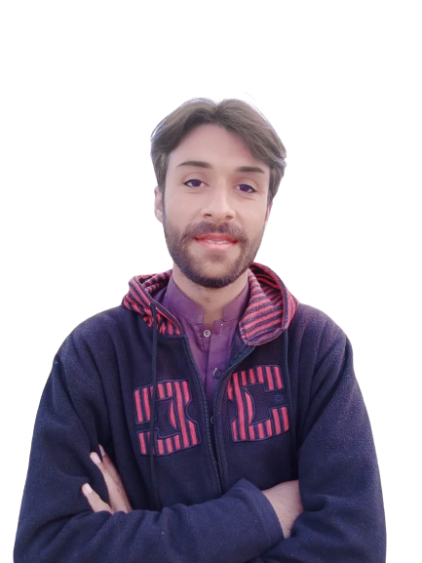
DAY 27
Python Exercises for Practices

Slide 2
Day 27
Python Exercises with solution for Practices
Python Problem 1 and Solution
Python Problem 2 and Solution Python Problem 3 and Solution
Python Problem 4 and Solution
Python Problem 5 and Solution

Slide 3
Python Exercise 1 with solution
1) Write a Python to Get name of user and Display user name in uppercase.

Slide 4
Python Exercise 2 with solution
2) Write a Python Program to get age of user and convert into seconds

Slide 5
Python Exercise 3 with solution
3) Write a Python Program to Get Three Number From User to Increase One Value To Every Number.

Slide 6
Python Exercise 4 with solution
4) Write a Python Program to Get a Number From User to Find Square Of That Number and Then Display Result

Slide 7
Python Exercise 5 with solution
5) Write a Python Program to Get 3 Number From User, Multiply 1st and 3rd Number and Then Add 2nd Number To Resultant

Slide 8
Next Day 28
Decision Making Structure
With
Examples

